Slide 1
Module 2 Introduction to Databases and DBMSs
Lesson 3: DBMS Overview and Database Definition Feature
Notes:
Welcome to Lesson 3 of Module 2 on the Introduction to Databases and DBMSs
- Covers DBMS definition and database definition feature, a distinguishing feature
Database management systems are vital technology to modern organizations
Opening question: How does a DBMS differ from desktop software such as a spreadsheet or word processor?

Slide 2
Lesson Objectives
Define DBMS
Explain DBMS product variations
Discuss the essential difference between a DBMS and desktop software
Notes:
Essential difference: level of planning involved with databases and DBMS software

Slide 3
Database Management System (DBMS)
Collection of components that support data acquisition, dissemination, storage, maintenance, retrieval, and formatting
Product variations
Enterprise DBMSs
Desktop DBMSs
Embedded DBMSs
Major part of information technology infrastructure
Notes:
DBMS (Database Management System): collection of components (mostly software)
Enterprise DBMS: supports mission critical information systems; very large dbs, many users, tight performance requirements
Desktop DBMS: end user departments and small databases; modest performance and reliability capabilities
Embedded DBMS: resides in a larger system, either an application or a device such as a Personal Digital Assistant or smart card. Embedded DBMSs provide limited transaction processing features but have low memory, processing, and storage requirements.
Features common to most DBMSs: database definition, non procedural access, application development, procedural language interface, transaction processing

Slide 4
Database Definition Feature
Define database before populating and using a database
Tables and relationships
SQL CREATE TABLE statement
Graphical tools
Notes:
Fundamental difference to other productivity software: amount of planning before using; defined database before using
Table: 2 dimensional arrangement of data; relationship: linking column among tables
SQL: industry standard database language

Slide 5
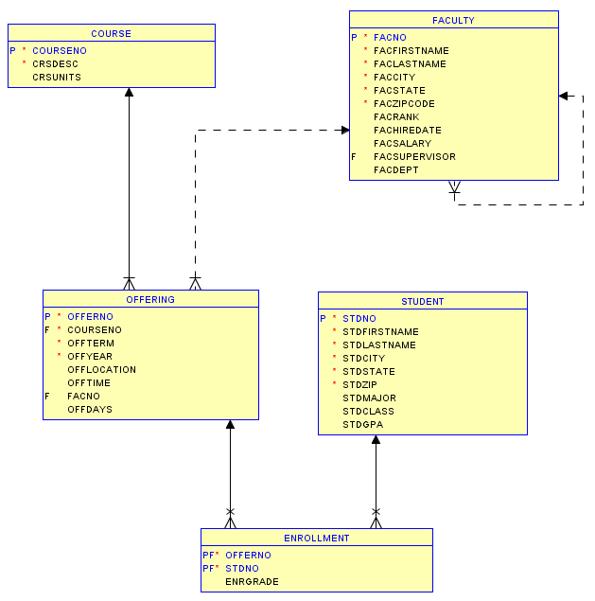
Oracle Relational Diagram
Notes:
Oracle Relational Diagram
Created in Oracle SQL Developer
Select New Design in Data Modeler -> Browser
Drag tables into design window
View Details: show only columns in this diagram
Can also show other details such as data types
Notation
Solid line: mandatory relationship (NOT NULL constraint for FK)
Dashed line: optional relationship (NULL values allowed)
Cross: FK is part of PK

Slide 6
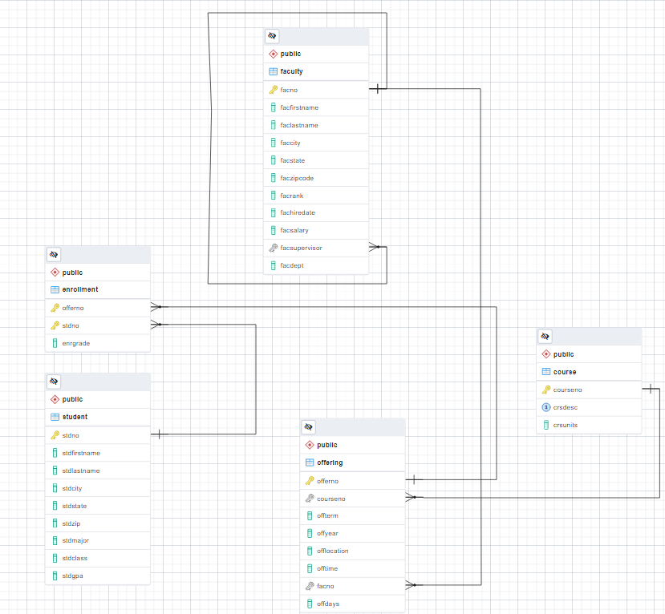
pgAdmin Database Diagram
Notes:
pgAdmin (client for PostgreSQL) Generate ERD tool
5 tables (student, enrollment, course, offering, faculty):
Relationships: lines connecting tables (faculty to offering); not all tables are directly connected
Must define the tables and relationships before entering data and retrieving data

Slide 7
Summary
Database technology supports daily operations and decision making
Define database before using it
Nonprocedural access is a crucial feature
Notes:
DBMS are very complex products
Devote many years to understand a particular product
Lots of planning and requirements collection when designing a database
DBMSs require database structure defined before populating and then using it.

